Slide 1
Mitigating Birds Strikes Aviation
By Anjali Thota
Batch:DA326S32

Slide 2
Problem Statement:-
Bird strikes can lead to aborted takeoffs, engine shutdowns, and other safety-critical events.
The increasing frequency of bird strikes poses a significant safety risk to aviation, with potential consequences for both aircraft and passengers
Objectives For Analysis
Regulatory_Complaince
Injury Preventation And Wildlife Conservation
Operational Efficiency
Cost Reduction
Risk Management
Communication and Training
Safety_Improvement_Management

Slide 3
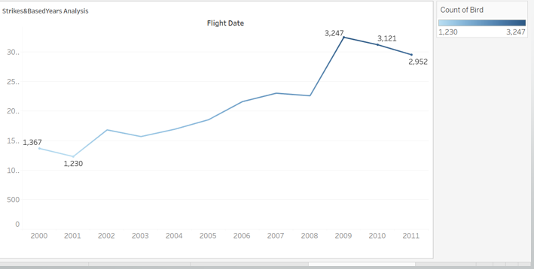
Safety Improvement Management
The number of bird strikes has been increasing over the years of 2005 to 2011.
The highest birds strikes in 2011 having the 3,247

Slide 4
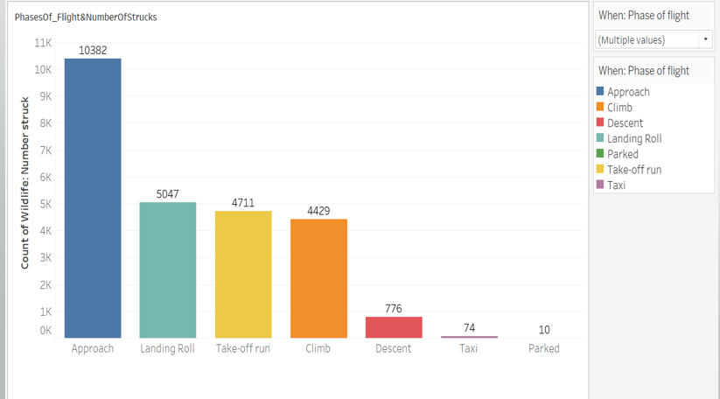
The most birds are struck during the Approach phase of flight 10,382

Slide 5
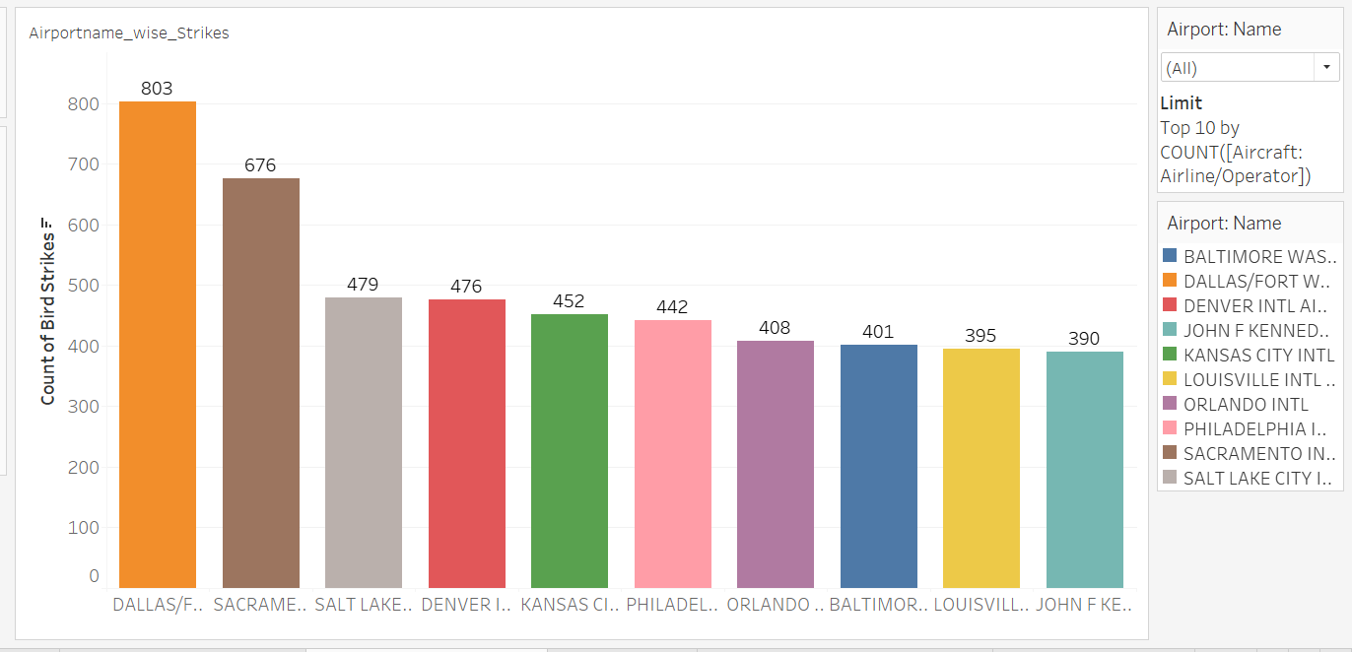
Regulatory_Complaince
The most birds are struck during the Country wise "Dolla's" 803.

Slide 6
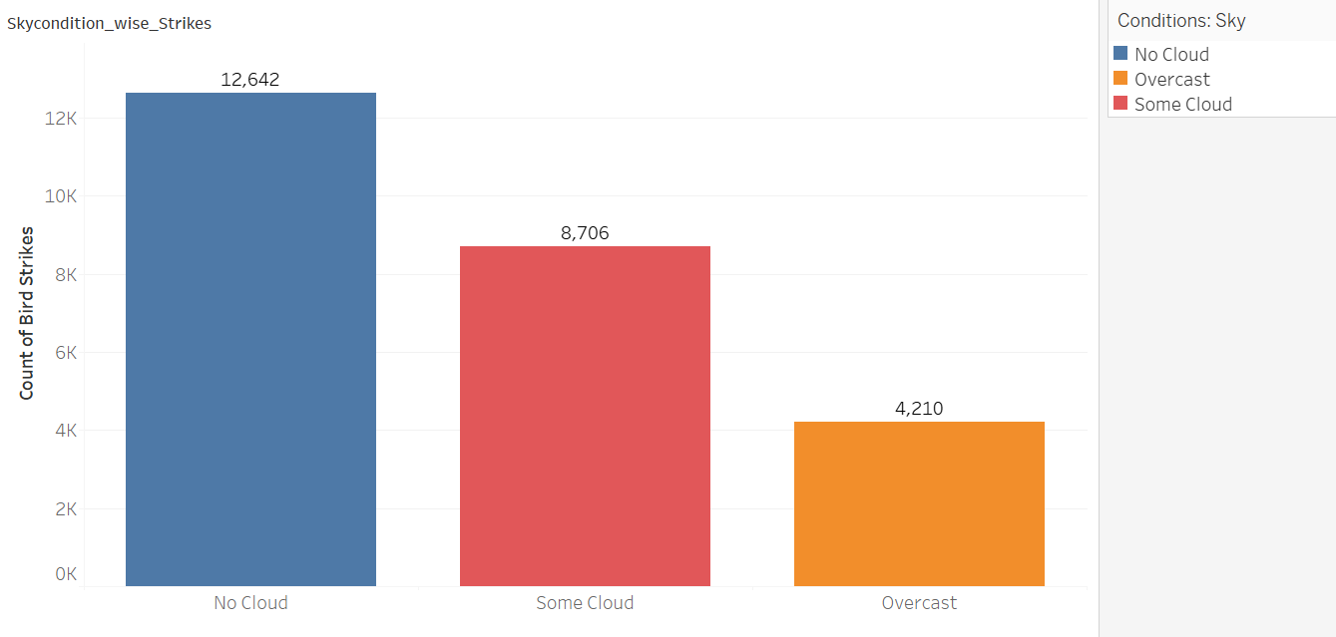
The birds Strikes having based on sky condition's:
No Cloud: 8,706
Some Cloud: 4,210
Overcast: 2,000

Slide 7
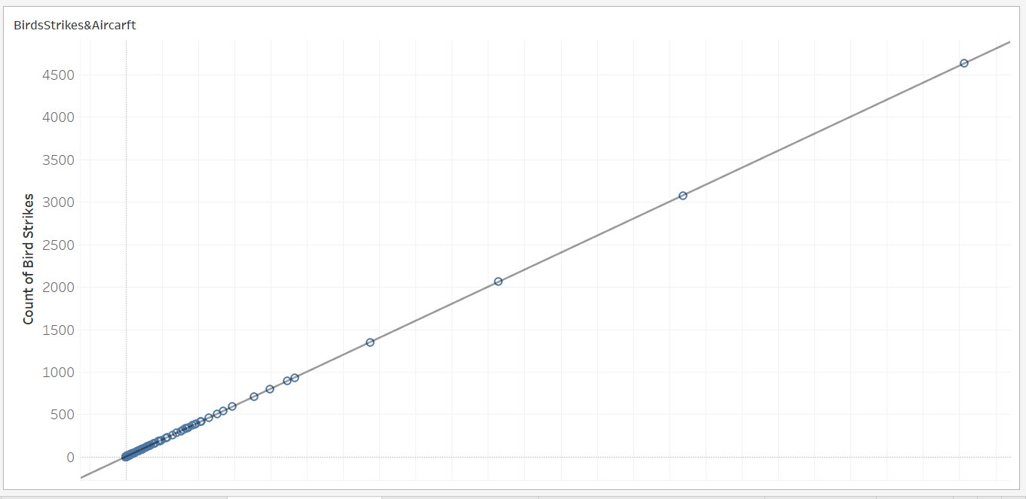
Injury_Preventation
The "Birds Strikes & Aircraft" Having the positive relation

Slide 8
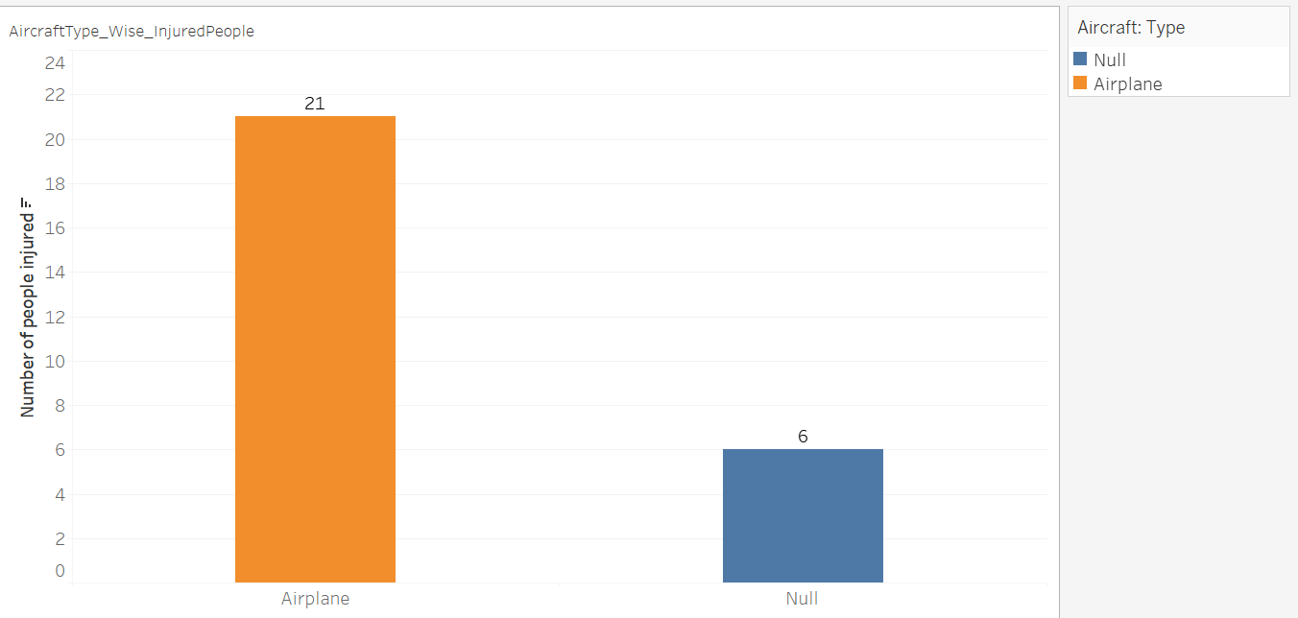
The category with the highest number of injured people (21) has a label of "Airplane"

Slide 9
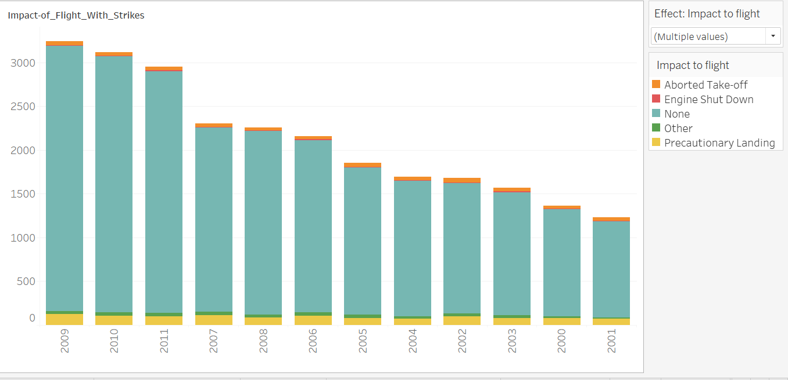
Operational Efficiency
The y-axis shows the impact to flight, which includes aborted takeoffs, engine shutdowns, precautionary landings, and other unspecified events. The x-axis shows the year.

Slide 10
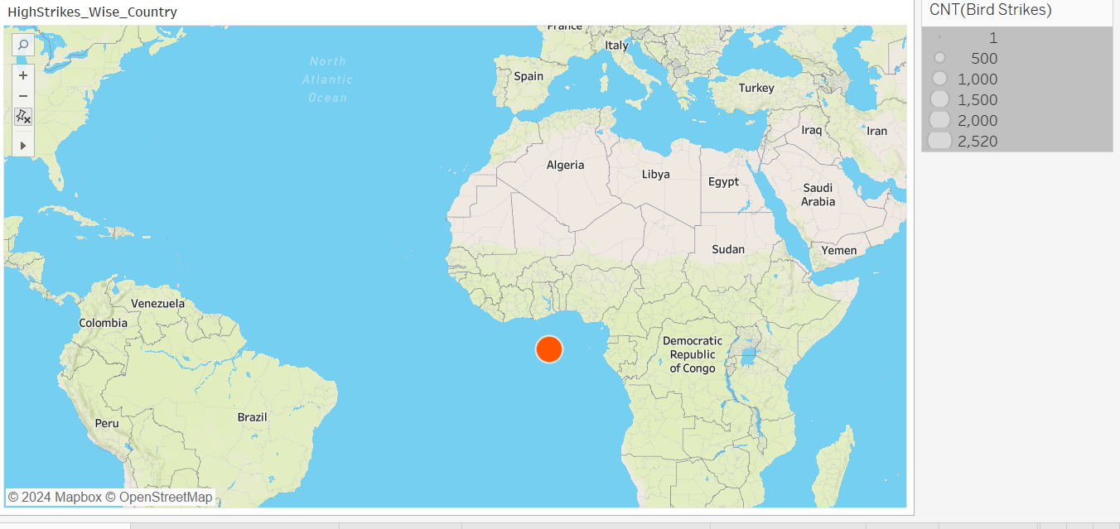
The most bird strikes out of the countries listed.
The Circle shows the Bird strikes country “ALBMA” With 2520

Slide 11
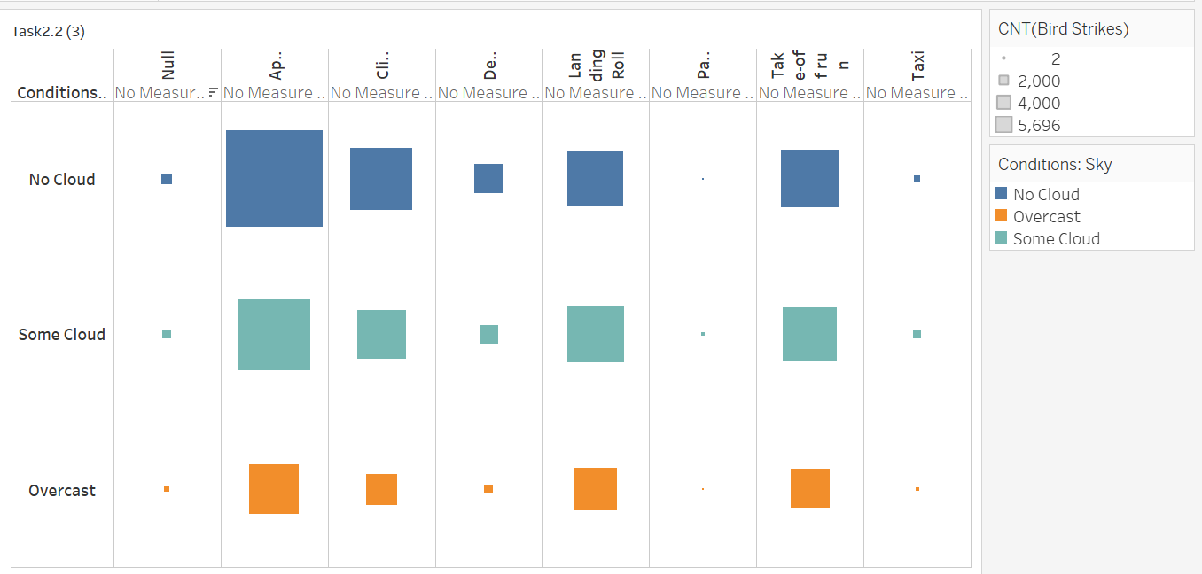
Risk_Management&Communication_Training
There are 4,000 clouds detected when there is no measurement for ceiling height, but there is a visibility measurement.

Slide 12
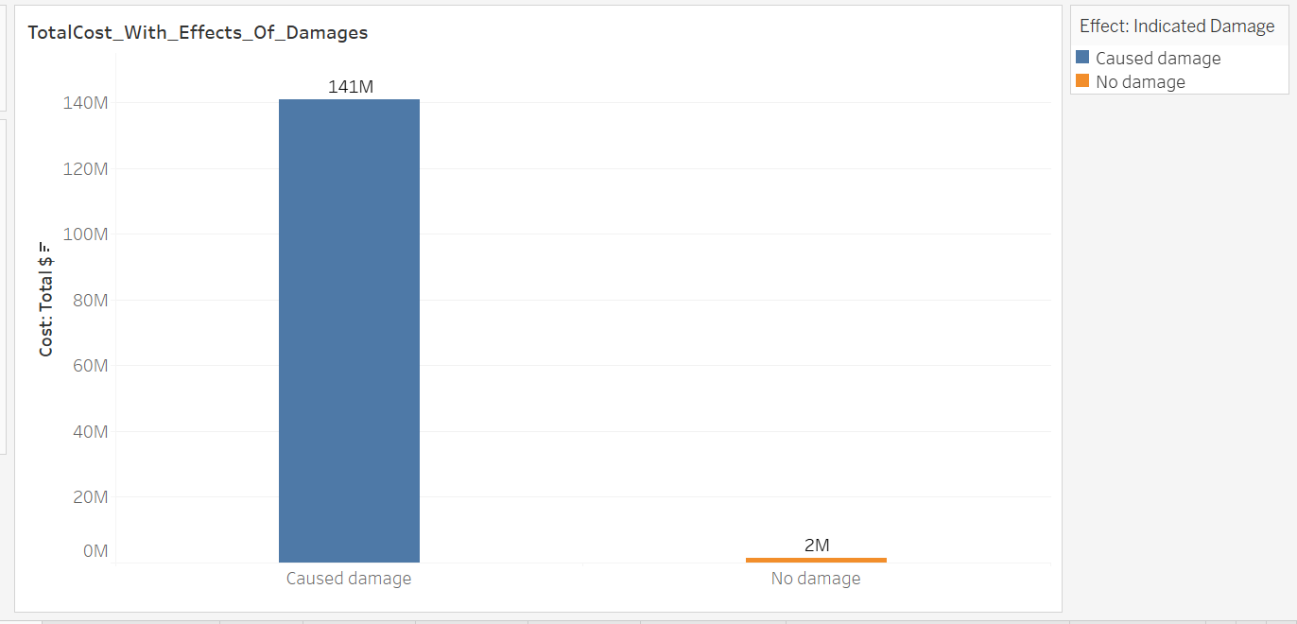
The cost of wind damage is 141 million dollars, whereas the cost with no damage is only 2 million dollars.

Slide 13
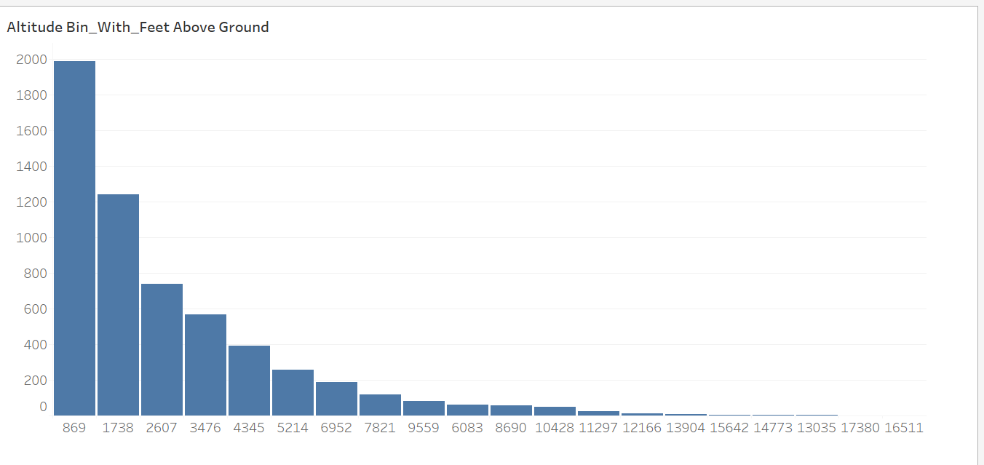
The y-axis shows the Distance of "Feet Of Ground" and the x-axis shows the Altudebin size when feet ground distance 832 having the most strikes

Slide 14
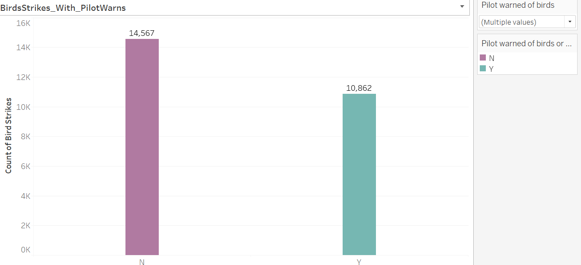
The blue data series shows the count of bird strikes where the pilot did warn of birds and the orange data series shows the count of bird strikes where the pilot did not warn of birds.

Slide 15
Conclusion:-
The number of bird strikes has been increasing over the years of 2005 to 2011.
The most birds are struck during the Approach phase of flight 10,382
The most birds are struck during the Country wise "Dolla's" 803.
The birds Strikes having based on sky condition's:
No Cloud: 8,706
Some Cloud: 4,210
Overcast: 2,000
The "Birds Strikes & Aircraft" Having the positive relation
The category with the highest number of injured people (21) has a label of "Airplane"
The most bird strikes out of the countries listed. The Circle shows the Bird strikes country “California”.
The y-axis shows the impact to flight, which includes aborted takeoffs, engine shutdowns, precautionary landings, and other unspecified events. The x-axis shows the year.
The y-axis shows the Distance of "Feet Of Ground" and the x-axis shows the Altudebin size when feet ground distance 832 having the most strikes.
There are 4,000 clouds detected when there is no measurement for ceiling height, but there is a visibility measurement.

Slide 16
THANK YOU

